Slide 1

Analysis on Doctor’s Consultation Fee City Wise

Slide 2
About me
Name: Amulya Sai. P
Qualification: M.Engg(Thermal Engg)
I want to study Data Science for career trasition
WORK EXPERIENCE : I have 1.5 yrs of experience in Sr. Technical recruiter(US/Domestic)
Name: Aparna
Qualification: MSc statistics
I want to study Data Science for career transition.
Work Experience: I have 2.6 yrs. of experience as analyst (Transaction monitoring )
Background ? (B-tech or M-tech)
Why you want to learn Data Science
Any work experience

Slide 3
Agenda (This should be the PPT flow)
Objective of the Project:
Web Scraping
Summary of the Data:
Exploratory Data Analysis:
Data Cleaning Steps
Data Manipulation Steps
Univariate Analysis Steps
Bivariate Analysis Steps
Key Business Question
Conclusion (Key finding overall)
Q&A Slide
Your Experience/Challenges working on Web Scraping – Data Analysis Project.

Slide 4
OBJECTIVE:
Analysing how the doctor’s consultation fee varies in Metropolitan cities and to compare in which location it is high

Slide 5
What and Why
Website Name: PRACTO
Link: https://www.practo.com/
LIBRARIES USED:
Data Visualization : Seaborn, Matplotlib(pyplot)
Data Cleaning : Pandas
Data Collection: Requests, BeautifulSoup, Pandas, Numpy

Slide 6
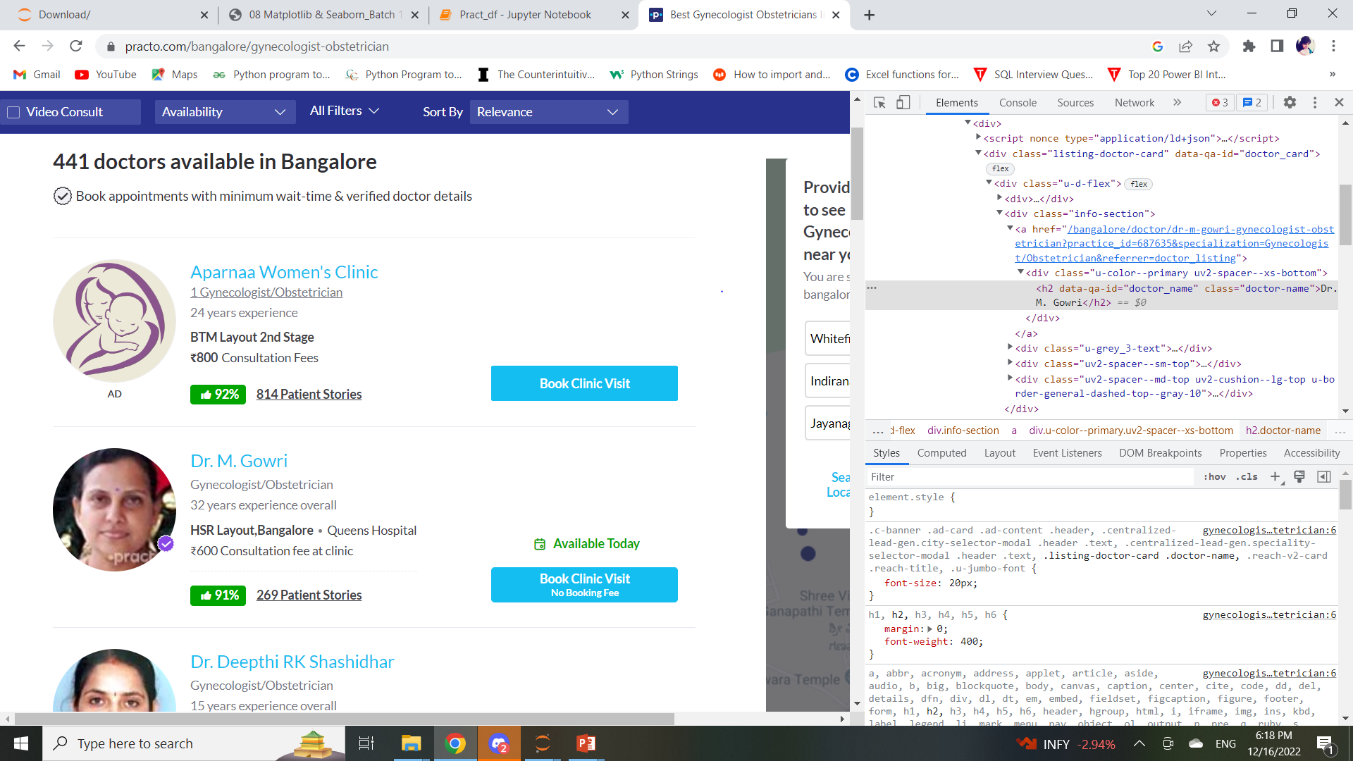
Web Scraping

Slide 7
Process of Data Collection:
We Extracted the links from each page which was done using requests.get and BeautifulSoup in the Practo website for every specialization link varies (no common weblink to use for loop).
After that we extracted the features (columns/values) using soup.findall() from each page of the website.
We used For loop and regular expression to get specified values and appended them into empty lists.
Checked whether all the lists are of same to create a DataFrame.
Then we have Created a dictionary using all the lists and using dictionary created the DataFrame.
The DataFrame Created was stored in the csv file for our convenient.

Slide 8
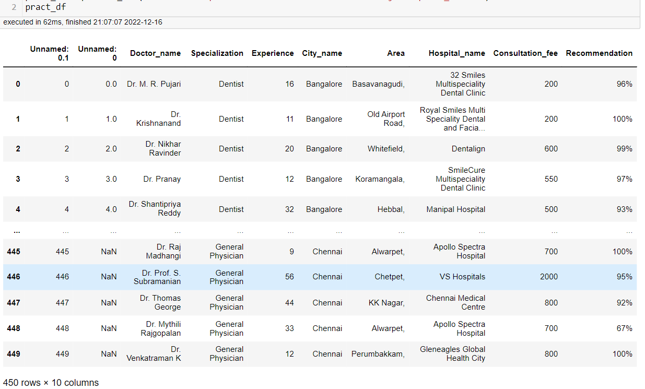
Collected Data:

Slide 9
Data Cleaning:
Removed the unwanted coloumns which are not necessary for Analysis.
Removing the duplicates: Checked weather any duplicated rows are there using duplicated() method and dropped them using drop_duplicates.
Similarly removed the special characters from Recommendation and Area coloumns using replace() function.
Handling missing values: checked for missing values using isna() method for each column and there are few missing values in Recommendation column. Calculated the percentages of missing values and it was less than 5%(.63%) so we removed those rows.
Identify Corrupted data: Changed the Data type using astype().
Finally cleaned Data was obtained

Slide 10
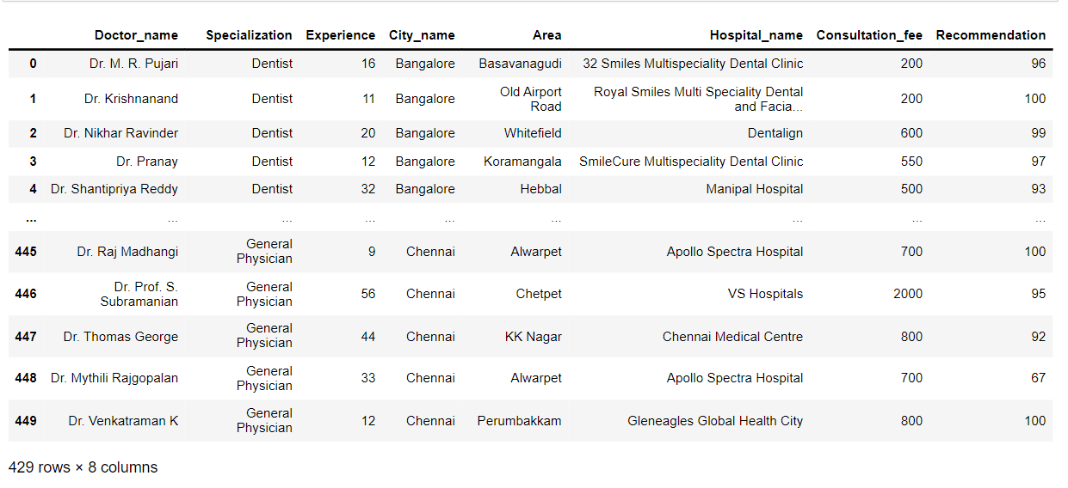
Cleaned Data

Slide 11
Data Analysis And Visualizations
1. Univariate Analysis:
Univariate analysis explores each variable in a data set, separately. Variable can be categorical or numerical.
2. Bivariate Analysis:
Bivariate analysis is a kind of statistical analysis in which two variables are observed against each other.
Possible combinations are:
1. Numerical – Numerical
2. Categorical – Categorical
3. Numerical – Categorical
3. Multivariate Analysis:
Analysis is done on more than two variable.

Slide 12
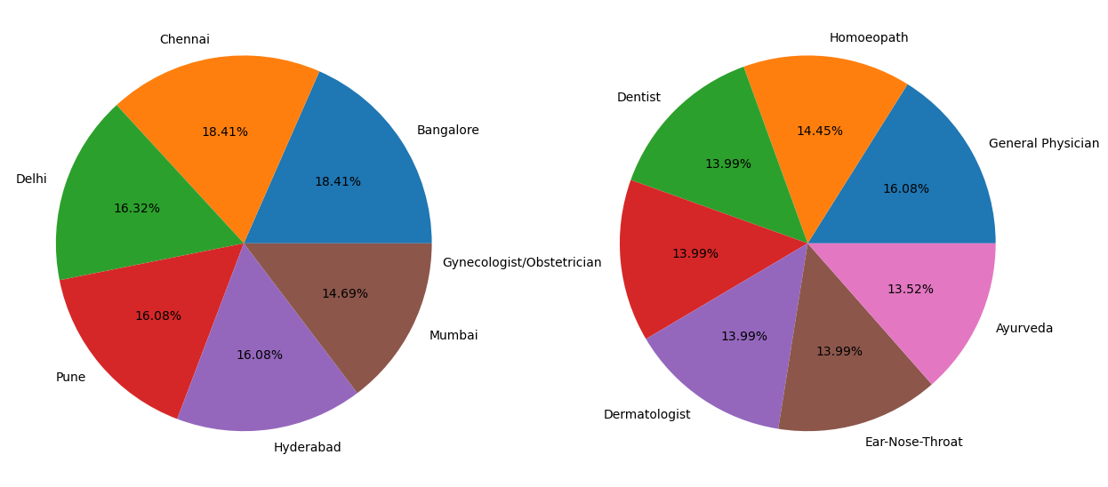
1. Univariate Analysis:
specialisation and location
City wise availability of Doctors are high in Chennai and Banglore[18.41%]
Specialization wise, General Physician[16.8%] are high among all cities

Slide 13
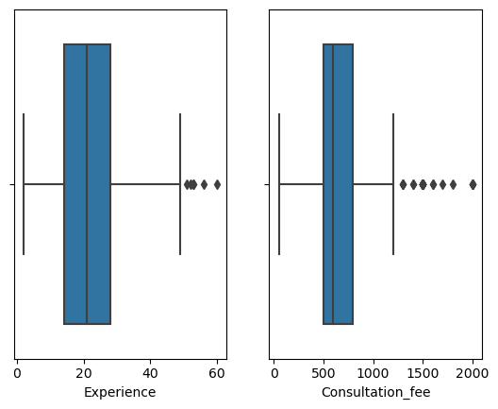
To check Outliers For Experience and Consultation Fee.
As we can observe there are outliers in the data.
Median of Consultaion_fee : 600
Median of Experience : 21

Slide 14
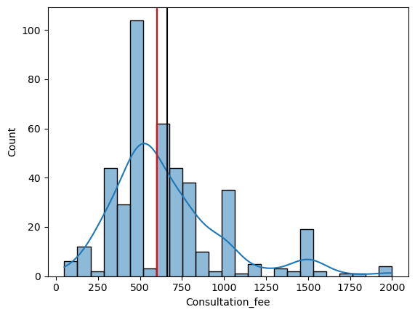
How the Consultation_fee values are distributed
In the above plot mean>median and kde line is more towards right which which is due to presence of outliers.
Mean (avg) of Consultation_fee: 661.0
Median of Consultation_fee: 600.0

Slide 15
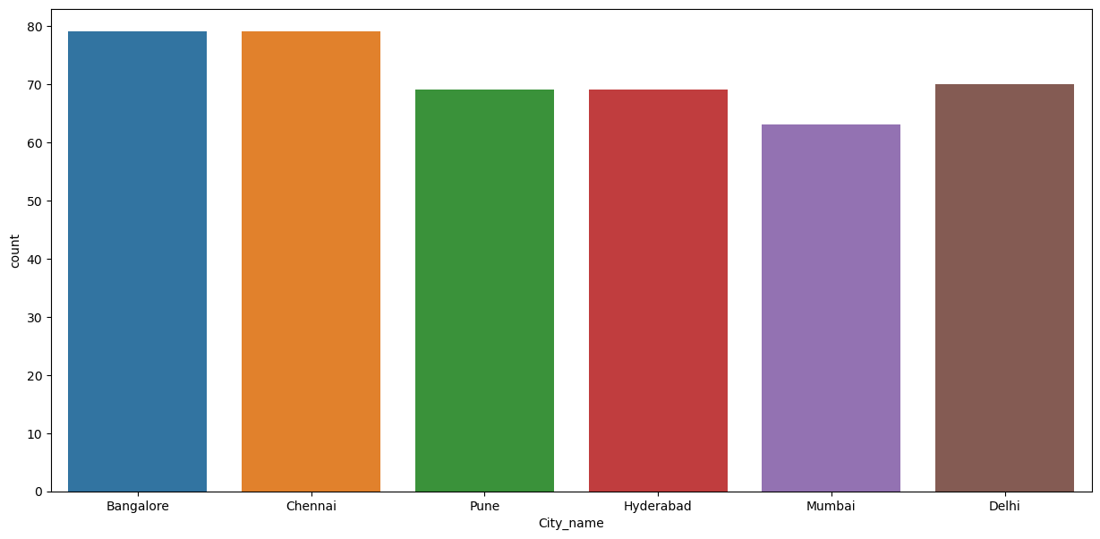
City Vs Count
Banglore and Chennai has more number of Doctors

Slide 16
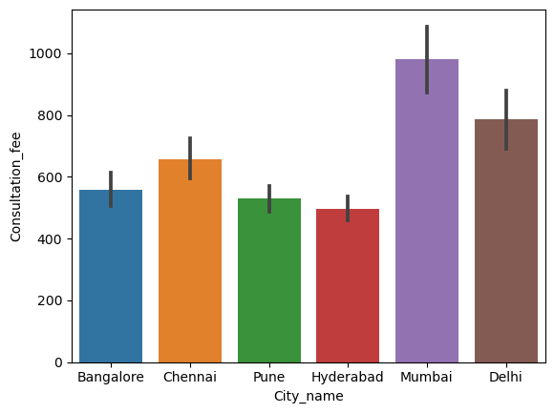
Bi-Variate Analysis City_name vs Consultation_fee
Average of Consultation_fee in Mumbai is High
Average of Consultation_fee in Hyderabad is less.

Slide 17
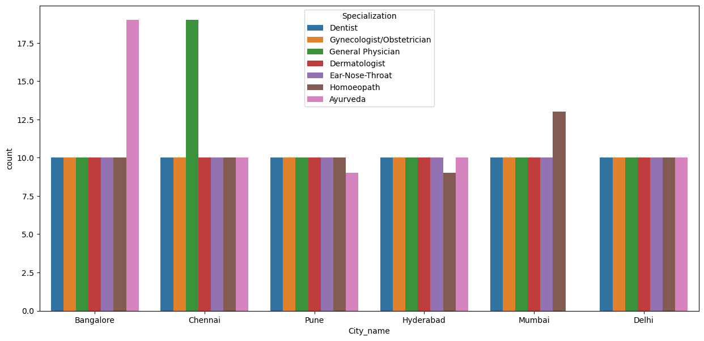
based on Specialization and City name
Almost all the specializations in each city have similar count highest count(doctors) is in Banglore(Ayurveda) and Chennai (general physian).

Slide 18
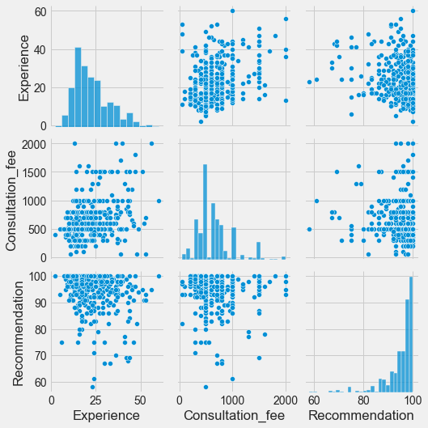
Paired Plot

Slide 19
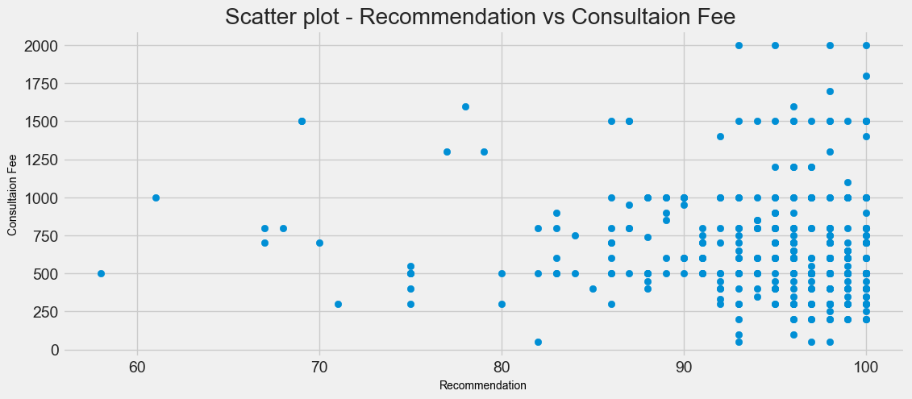
Relationship between Recommendations and Consultation_fee
Values are scattered randomly, no correlation between recommendation and consultation fee.

Slide 20
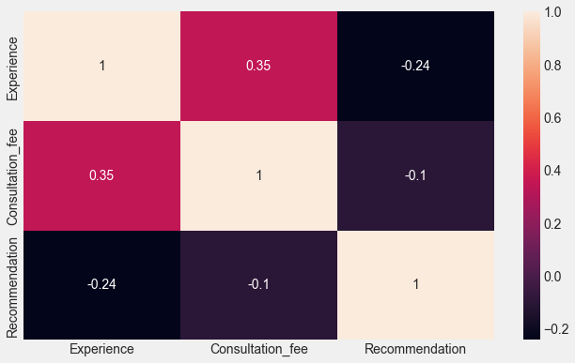
Multivariate Analysis
Correlation: it is a relationship between two or more variables, it is important because if we know the relationship btw the variables we can make predictions about future.
In This plot, there is negative correlation values and positive.
Close to one positive correlation(one increase other increases.
Close to 0 no correlation.
Close to –1 negative correlation.

Slide 21
Descriptive Statistics(Data Summary)
Consultation Fee |  |  |  |  | Experience |  |  |  | Recommendation
 | Mean | Median | Max | Min | Mean | Median | Max | Min | Mean | Median | Max | Min
City_name
Bangalore | 558.088608 | 500.0 | 1200 | 200 | 22.481013 | 21.0 | 52 | 8 | 95.759494 | 97.0 | 100 | 68
Chennai | 657.594937 | 700.0 | 2000 | 200 | 24.025316 | 22.0 | 60 | 2 | 95.012658 | 98.0 | 100 | 61
Delhi | 787.571429 | 700.0 | 1800 | 50 | 23.257143 | 21.0 | 53 | 9 | 95.242857 | 96.5 | 100 | 79
Hyderabad | 494.927536 | 500.0 | 1000 | 51 | 19.913043 | 19.0 | 42 | 8 | 94.130435 | 97.0 | 100 | 58
Mumbai | 980.158730 | 800.0 | 2000 | 200 | 24.920635 | 23.0 | 53 | 5 | 93.761905 | 96.0 | 100 | 69
Pune | 528.985507 | 500.0 | 1000 | 100 | 20.463768 | 18.0 | 44 | 6 | 94.550725 | 96.0 | 100 | 75

Slide 22
Conclusion:
Among all the Cities, Consultation fee is high in Mumbai(Rs 2000) and low in Delhi(Rs 50).
Highest paid doctors are available in Chennai and Mumbai(maximum fee is high in those cities).
Coming to experience, even more experienced doctors are also in Chennai and second is Mumbai.
Recommendation of doctors is high in Chennai.
Among all cities Hyderabad and Pune has less average Consultation fee .

Slide 23
Q & A

Slide 24

THANK YOU

